Slide 1

Art of Enterprise UCIL24002
Unit Overview
Lynn Sheppard
Director, Manchester Enterprise Centre

Slide 2
My Background
Science background – undergraduate and postgraduate degrees in Chemistry
My early career was in the area of advertising and marketing both on the agency and client side and I’ve set up and managed three companies
  Licensing agency
  Marketing consultancy
  Advertising agency
Chartered member of the Institute of Marketing and the Institute of Personnel Development
Director of Manchester Enterprise Centre
My office location – 5.16 Roscoe Building
My e-mail contact details – l.sheppard@manchester.ac.uk

Slide 3
Icebreaker…
If you could choose to work for any organisation in the world, who would you choose and what job would you want to do?

Slide 4
What motivates you…
What are you passionate about?
What is really, really important to you?
What makes life worth living?
What makes you want to take action?
What is your vision for your future?
What is your career goal?
What do you need to do to achieve this?
Define your goal…
‘I’ll tell you what I want. What I really, really want’

Slide 5
Rate your agreement with each of the following statements …
Read each statement and answer honestly about yourself.
Entirely Agree Somewhat Agree Neutral Somewhat Disagree Entirely Disagree
5 4 3 2 1
I prefer to only do things that are fun…
I like to be rewarded for extra responsibilities …
It is important that others appreciate the work I do…
Decisions I make reflect my personal standards…
I work hard for a company if I agree with its mission…
Barbuto 2002

Slide 6
What matters to me…
I prefer to only do things that are fun Intrinsic Process - for fun
I like to be rewarded for extra responsibilities Instrumental - for money
It is important that others appreciate the work I do Self-concept external - reputation
Decisions I make reflect my personal standards Self-concept internal -achievement
I work hard for a company if I agree with its mission Goal internalisation -principles
Barbuto 2002

Slide 7
My goals and dreams…
I really love to . . .
I’m very good at . . .
What I really want to have is . . .
What I really want to do is . . .
What I really want to be is . . .
Work that I would do even if I didn’t get paid is . . .
Someone I really admire for his or her achievements is . . .
The best compliment anyone can say to me is . . .
One of my biggest dreams is . . .

Slide 8
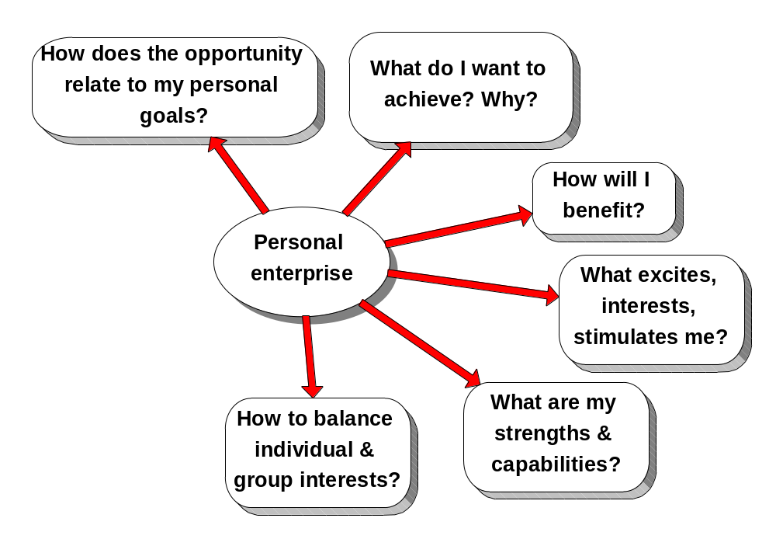
Personal enterprise…

Slide 9

‘A society’s competitive advantage will come not from how well its schools teach the multiplication and periodic tables, but from how well they stimulate imagination and creativity.’
Albert Einstein

Slide 10
Enterprise and Entrepreneurship Education
Enterprise education equips students with an enhanced capacity to generate ideas and the skills to make them happen
Entrepreneurship education equips students with the additional knowledge, attributes and capabilities required to apply these abilities in the context of setting up a new venture
Enterprise and entrepreneurship are trans-disciplinary, with a high degree of application to key issues such as employability, innovation, knowledge transfer and commercialisation

Slide 11
Enterprise and Employability
‘Enterprise is the sense of initiative and ambition that compels us to undertake a new commercial venture or to innovate within an existing organisation.’
Enterprise skills enhance the employability of graduates. Enterprise helps to explain the potential fit of degree subject skills into commercial contexts.
In addition to analysing how typical businesses function, enterprise specifically encourages problem solving. To identify and exploit opportunities with regard to both technical and market factors arising within and outside the organisation.
Employers value highly the ability of graduates to work in teams, plan time and resources, identify and resolve complex problems and clearly communicate within a business environment.

Slide 12
Entrepreneurial capabilities
Personal organisation: effectiveness and energy
Interpersonal interaction:
social competence
Investigating opportunity:
find, explore and select opportunities
Applying innovation:
new ways of meeting needs
Strategic venture planning:
successful planning & resource capture
Market development: defining and selling to target markets

Slide 13
The Art of Enterprise
The ‘art of being enterprising’ is being able to turn ideas into innovations - to make it really happen and to effect change. This unit looks at how organisations, both large and small, create value through the recognition of good ideas and how a good idea can evolve and ultimately be transformed into an opportunity which an organisation can create value from.
The unit looks at this from a range of different perspectives - history, nature, art and music; helping us to think in a more creative way; to better understand the problems and the challenges that are faced; and highlighting the importance of creativity and ‘opportunity spotting’ across all business areas.
The unit is delivered as a series of lectures - by the end of the unit you will be able to appreciate the importance of creating value with innovative approaches to business thinking and practices.
The unit will expand your appreciation of the working environment whilst developing the practical skills that employers are demanding.

Slide 14
Entrepreneurship and Management
Entrepreneurship is focused on identifying new opportunities, innovating and acting to exploit market opportunities
Management is concerned with the direction, control, resourcing and administration of the business organisation
Both are needed for a business enterprise to achieve long-term success

Slide 15
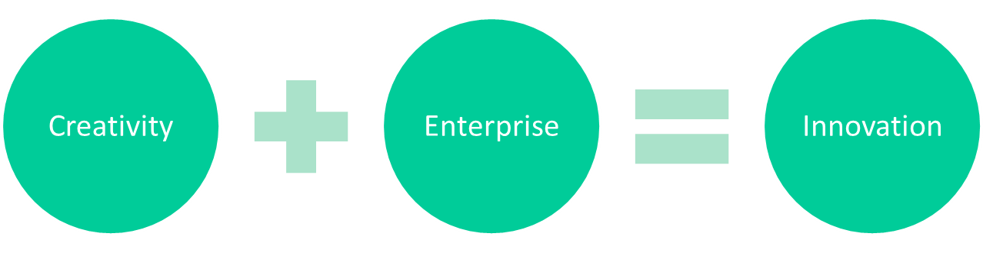
The Art of Enterprise
Idea
Change
Evolution
Opportunity
  Leadership
  Judgement
  Networks
  Planning
  People
  Resources
  Funding
  Connections
  Action
Notes:
The ‘art’ of being enterprising – is to make it really happen…To effect change…This takes work and effort…

Slide 16
Learning Outcomes
Knowledge and Understanding
Appreciate the process of idea generation, evaluation and creating value for both entrepreneurs and organisations
Recognise the variety of internal and external forces impacting on businesses today, both in the profit and not for profit sectors
Appreciate key business and management concepts
Intellectual Skills
Critically evaluate the role creativity has within an organisation
Review the relationship between creativity, innovation, management and entrepreneurship
Critically evaluate the role creativity and its models play in the value creation process

Slide 17
Learning Outcomes
Practical Skills
Identify and extract relevant information
Demonstrate analytical and critical skills by applying concepts methods and concepts
Demonstrate written and oral presentation and communication skills
Develop the ability to frame and solve problems and think creatively
Transferable Skills and Personal Qualities
Demonstrate teamwork skills and work constructively in groups
Communicate in an effective manner
Develop commercial awareness
Utilise problem-solving skills
Develop and apply research skills

Slide 18
Assessment
Assignment (4,000 words maximum) 100%

Slide 19
Formative - Individual Work
You are asked to submit a one-page outline giving details of the enterprising company you have selected for the individual summative assignment
This one-page outline must be submitted to Turnitin on Blackboard by 3pm 16 February 2018; you will receive feedback in week 6
Formative work - Individual Assignment Outline
Company name
Brief description of business (100 words)
Brief outline of how this business connects both ‘entrepreneurial’ and ‘managerial’ skills to sustain the business (100 words)
Key references

Slide 20
Summative - Individual Assignment
Select an enterprising business that you are able to research; use the entrepreneurial management model (Entrepreneurship from opportunity to action, Rae, Palgrave Macmillan, 2007 page 206) to analyse aspects of both the ‘entrepreneurial working’ and ‘managerial working’ of the company. Explain the importance of each in creating value for the organisation.
Your final assignment should be no more than 4,000 words in length, excluding references and appendices. Your work should include clear references to literature and internet sources.
The course textbook is important for this work but also look at a range of other sources available via the library and the web. Wherever possible, give examples to illustrate your answer.
It must be submitted to Turnitin on Blackboard by 3pm on Friday 11 May 2018

Slide 21
The Entrepreneurial Management Model
  Rae has argued that management needs to connect and balance both ‘entrepreneurial’ and ‘managerial’ skills in order to grow and sustain an organisation. Think of it as a see-saw.
  The academic literature has suggested that large corporate ventures need to ‘reignite the passion’ for new business opportunities within a company and ‘address the tension’ between strategic management and entrepreneurship.
  The ‘Entrepreneurial Management Model’ (Rae) shows the two modes integrated and creating new value without the tensions identified between the implicit values of each mode.

Slide 22
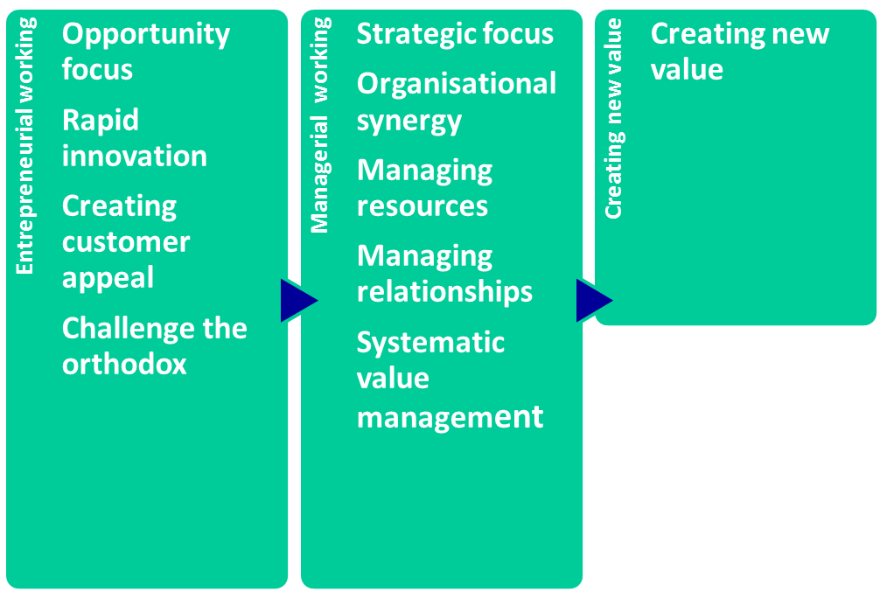
The Entrepreneurial Management Model
David Rae, 2007
Notes:
Entrepreneurship is concerned with the creation and exploitation of the opportunity, connecting innovation with market need; whereas management is concerned with the organisation of the business venture. Both are needed to establish and then to grow and develop a successful and sustainable enterprise.

Slide 23
Reading References
Main Texts
Entrepreneurship – from opportunity to action, Rae, Palgrave Macmillan, 2007
Opportunity-Centred Entrepreneurship, Rae, Palgrave MacMillan, 2015
Innovation and Entrepreneurship, Bessant & Tidd, Wiley, 2007
Understanding Enterprise, Entrepreneurship & Small Business, Bridge, O’Neill, Palgrave Macmillan, 2003
Further Reading
The Medici Effect, Johansson, HBS, 2006
Re-imagine, Peters, Dorling Kindersley, 2003
Managing Innovation, Design & Creativity, Von Stamm, Wiley, 2003
Managing Strategic Innovation and Change, Tushmann & Anderson, Oxford, 2004
The Art of Innovation, Kelley, Profile Books, 2001
Leading the Revolution, Hamel, HBS, 2000

Slide 24
Outline Syllabus
SESSION TOPIC
1 Induction & overview
2 Creativity
3 Opportunity to Action
4 Innovation & Change - Music
5 Innovation & Change – Nature
6 Summative Assignment Seminar – Formative feedback
7 Innovation & Change - History
8 Innovation & Change - Art
EASTER BREAK
9 Organisational Learning
10 Team management & effectiveness
11 Engaging in networks
12 Bringing it all Together

Slide 25
Manchester Enterprise Challenge
One of a range of awards that combine University College academic provision and extra-curricular activity.
The Manchester Enterprise Challenge has two components:
  Completion of a 10 credit ‘enterprise’ University College unit (two to choose from)
  Completion of an approved ‘enterprise’ activity project – which might involve working with a locally based business, charity or social enterprise to address and analyse a specific improvement opportunity (assuming around 20 hours of work)
  The extra-curricular project can be undertaken as part of a group or as an individual and at times that are flexible
  Recommendations will be presented as a PowerPoint ‘pitch deck’
  ‘All economies are hoping to inspire young people, especially graduates, to have the confidence and competences to move effortlessly into the world of work. By offering
  students the opportunity to engage with enterprise in a variety of ways as an applied
  concept will enhance the employability options of our graduates.’

Slide 26
Any Questions?
‘Times are tough…to secure a job graduates need not only an excellent degree but the ability to apply their skills in the workplace; requiring beyond subject-specific knowledge.’

Slide 27

Any Questions?
‘Times are tough…to secure a job graduates need not only an excellent degree but the ability to apply their skills in the workplace; requiring beyond subject-specific knowledge.’

